Slide 1
Week 10: Functions and Modules
ICT – Fall 2025/26

Slide 2
Learning Objectives
By the end of this lecture, you will be able to:
• Define and call functions
• Create and reuse your own modules
• Import and use existing modules
• Create and manipulate dictionaries

Slide 3
Special Note of Thanks
Grateful to the valuable feedback.
Some feedbacks were the reason behind making these slides.

Slide 4
Schedule
Today: Functions/modules and dictionaries
27th Nov: From basic data structures to actual data
04th Dec: Data Organization & Functional Programming
11th Dec: OOP in Python+GitHub
18th Dec: DBs Overview (more theory; less practice)
* Note: 25th Dec is a public holiday, so I need a make-up lab (in fact, we need 2 as we missed the very first one)

Slide 5
Agenda
Python warm-up/recap
Functions
Modules
Dictionaries
Summary

Slide 6
Warm-Up & Recap
Quick quiz:
1. Difference between list and tuple?
2. Print even numbers from 1–10.
3. Check if a number is divisible by 3.
Goal: Get back into logic mindset.

Slide 7
Functions
Often, there’s a code we have to reuse. We can use functions there.
Functions aren’t something alien. We have already seen them in Excel.
To define a function, we use the keyword def followed by the function’s name.

Slide 8
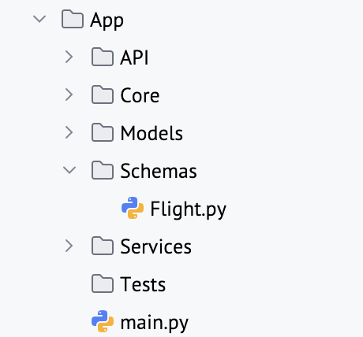
Creating Your Own Modules
As the code grows, inevitably it needs to be organised.
Just like your files, code can also be organised among folders.
Modules can be simply called as:
import Module
We can call any function from the (referred) module: Module.function()
Benefits: Cleaner code, easy to maintain

Slide 9
Importing Existing Modules
Python comes with many built-in modules.
We have already used math somewhere before.
  import math
  print(math.sqrt(16))
There are many other modules and we will cover some of them in the next week.

Slide 10
Dictionaries in Python
Dictionary = key-value pairs
Remember the airports and distance thing we done in the start?
Dictionaries implement it perfectly having key (airport code) and values (coordinates tuple) aligned.

Slide 11
Homework
1. Create my_calculator.py with add, sub, mul, div functions.
2. Import it into main.py and take user input.
3. Dice game: roll 2 dice until doubles (use random).

